Slide 1
Model Evaluation and Tuning:

Slide 2
Phase 1: Dropouts and Number of Neurons in Conv. Layers

Slide 3
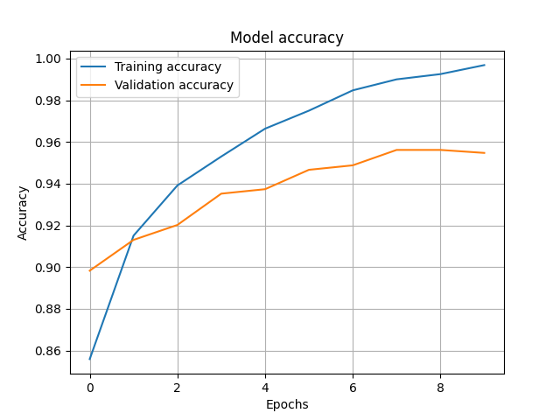
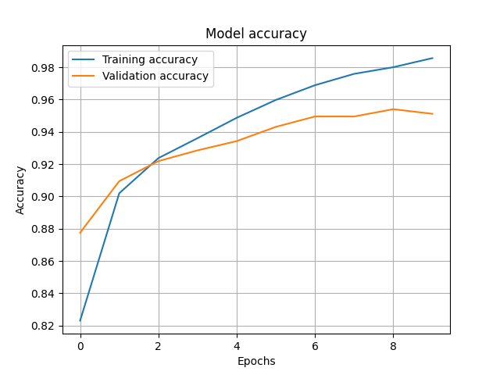
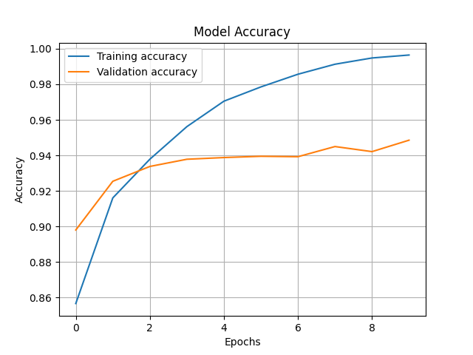
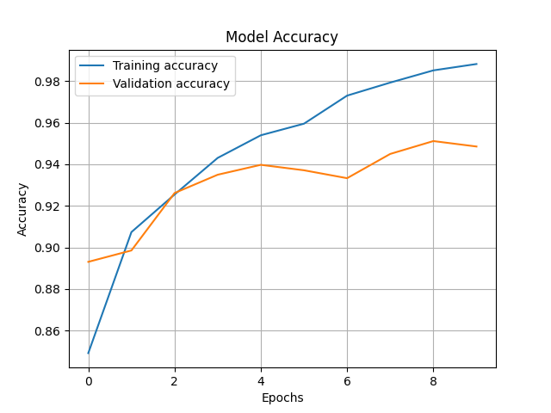
1. Accuracy vs Epoch
Senario 1
Senario 2
Senario 3
Senario 4

Slide 4
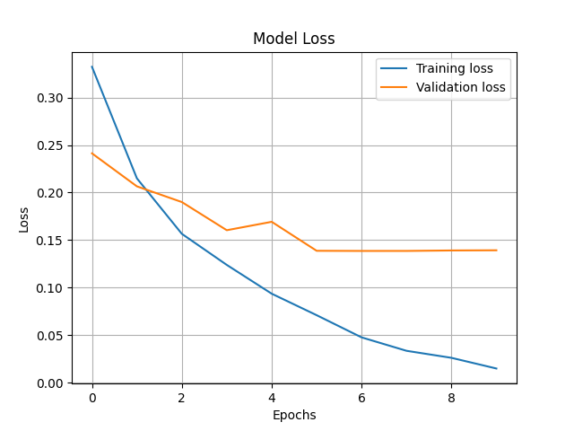
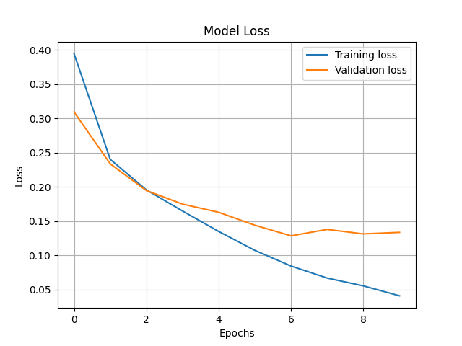
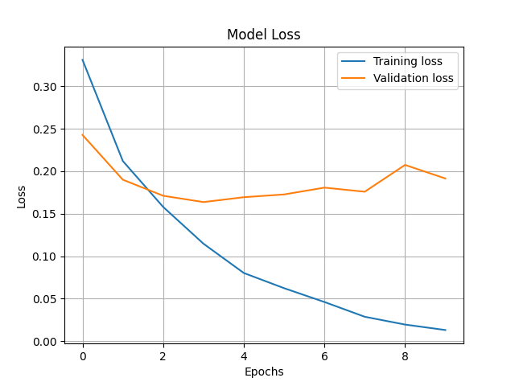
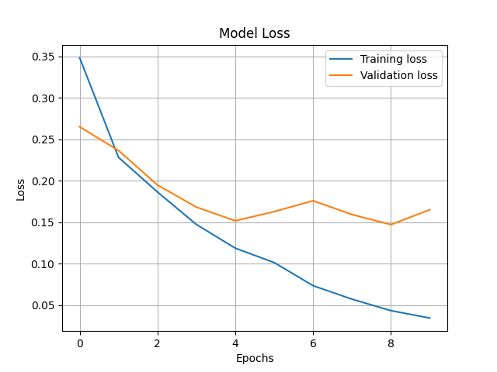
1. Loss vs Epoch
Senario 1
Senario 2
Senario 3
Senario 4

Slide 5
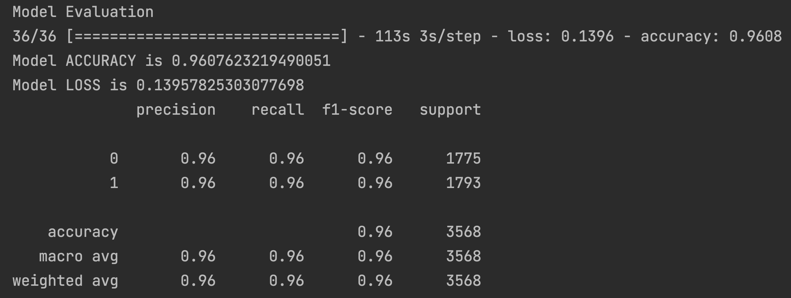
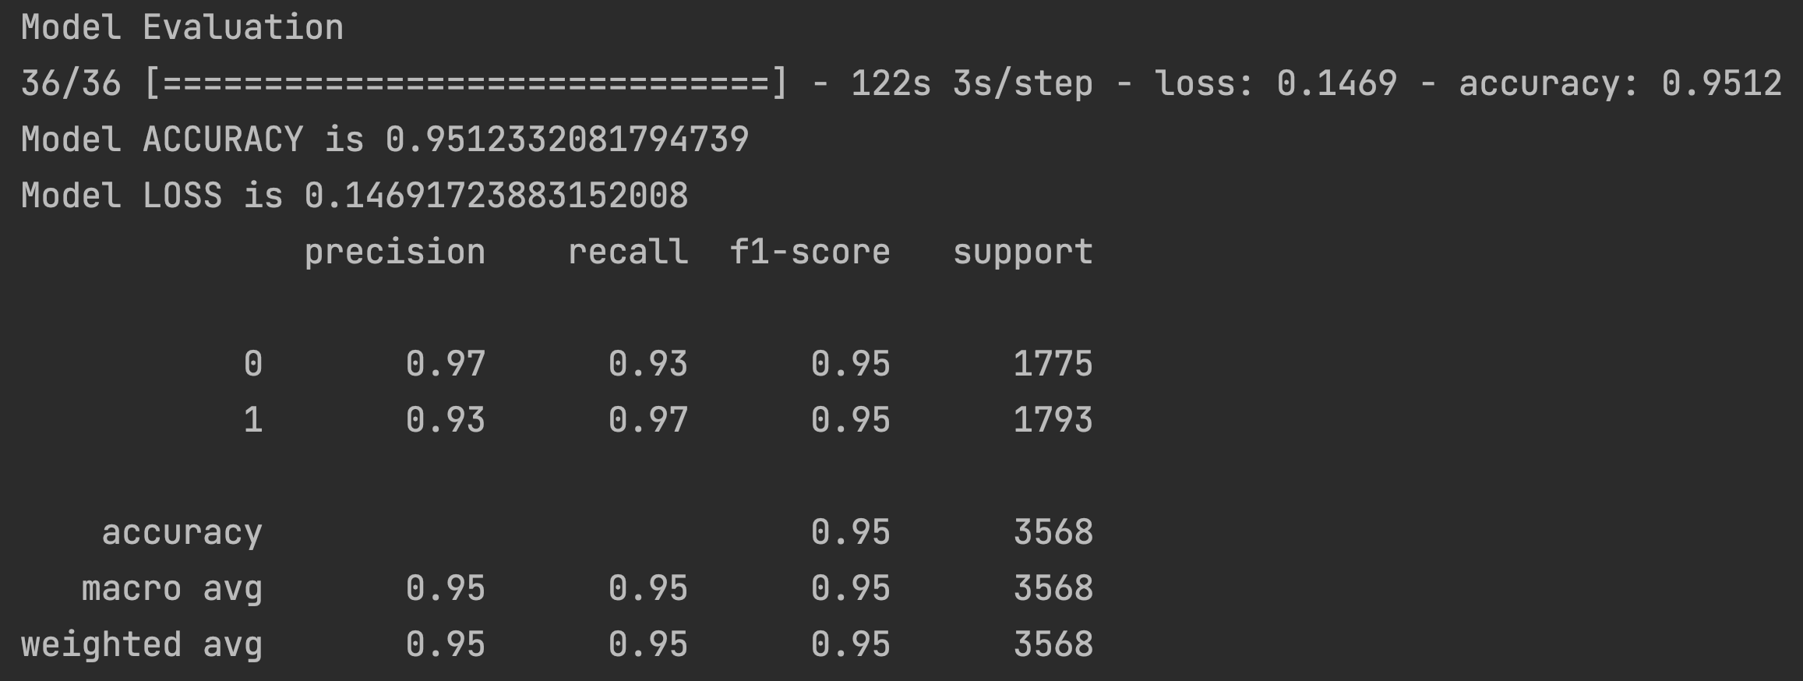
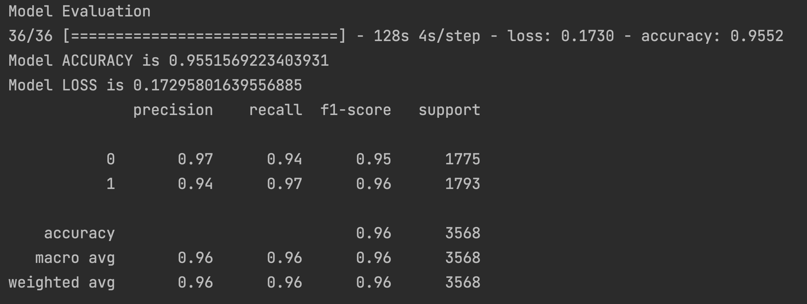
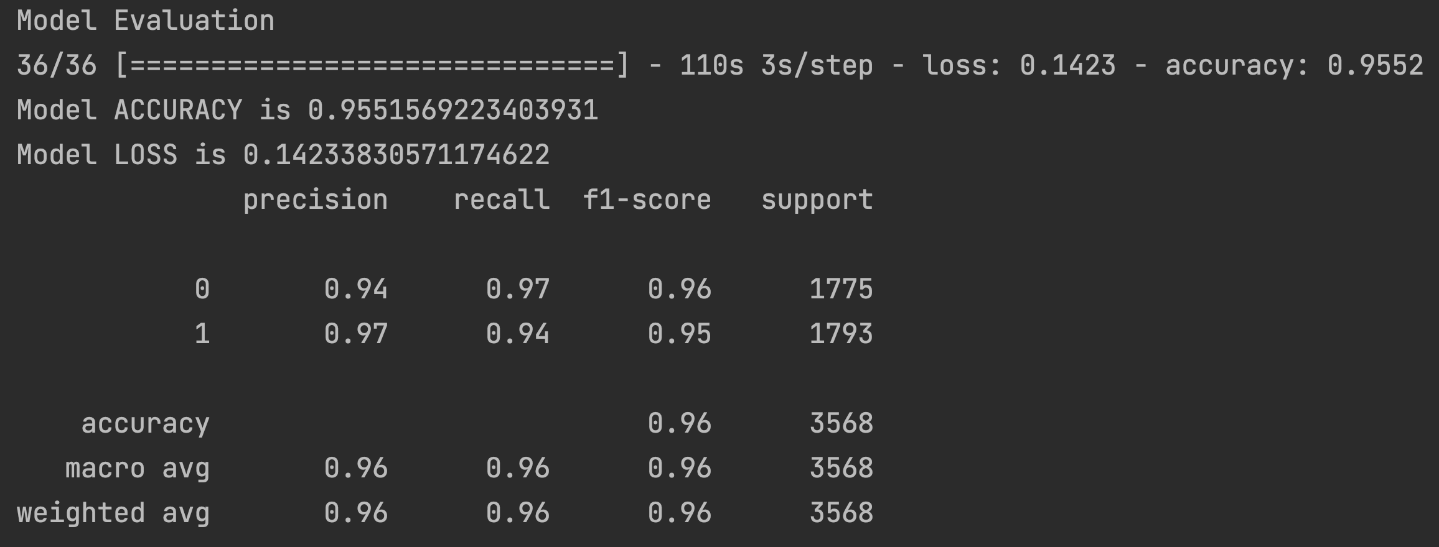
1. Classification Report
Senario 1
Senario 2
Senario 3
Senario 4

Slide 6
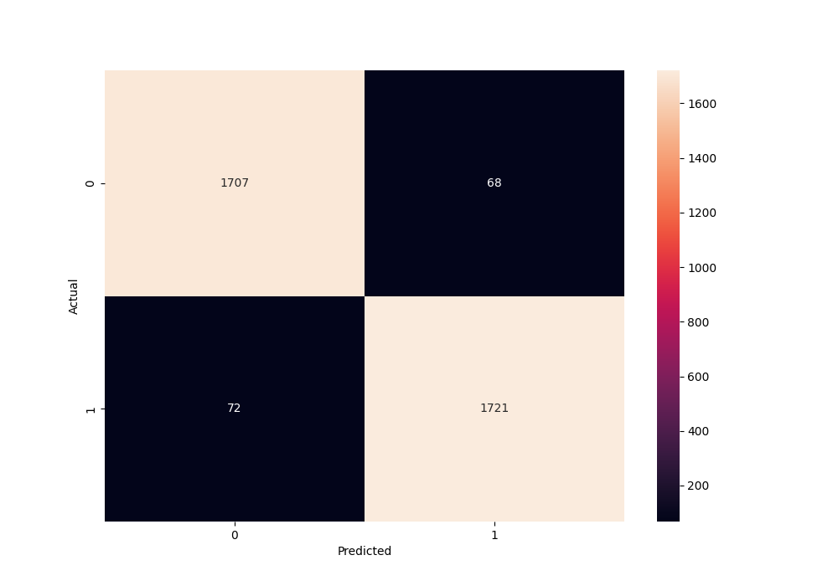
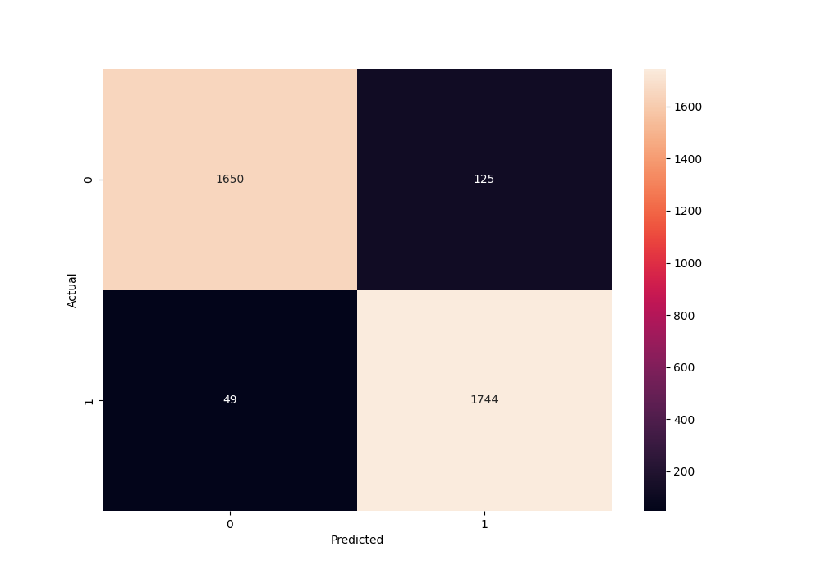
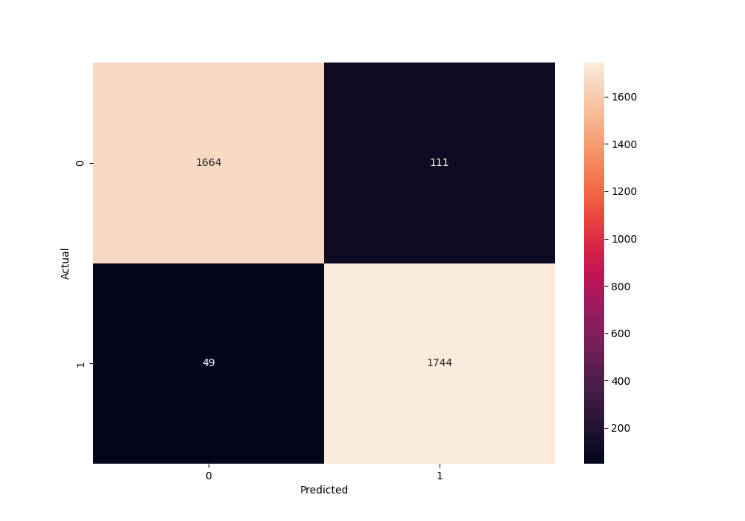
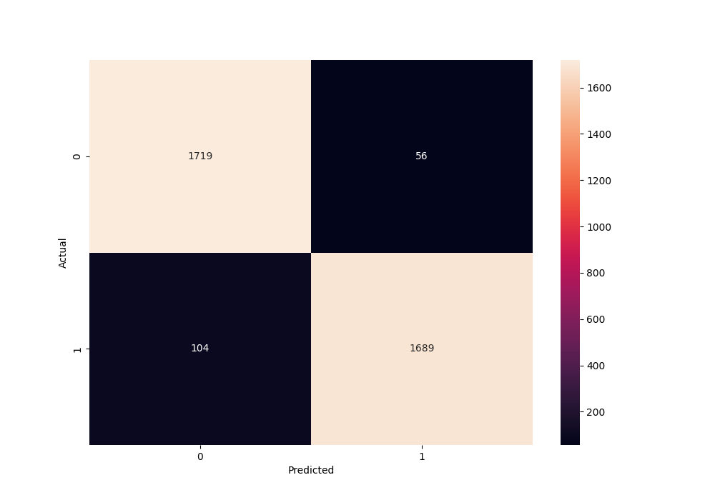
1. Confusion Matrix
Senario 2
Senario 3
Senario 1
Senario 4
Senario 4

Slide 7
Analysis:

Slide 8
Phase : Dropouts and Number of Neurons in Conv. Layers

